Slide 1

Notes:
Today I’m going to talk about IdentityTheft.gov, the federal government’s one-stop resource to help people report and recover from identity theft.

Slide 2
17.6 million
identity theft victims in 2014 (7% of US population)*
Nearly 500,000 complaints
to the FTC in 2015.
*U.S. Dept. of Justice, Bureau of Justice Statistics, Victims of Identity Theft, 2014 (September 2015)
Notes:
First – a little background. According to the Department of Justice, 17.6 million people were identity theft victims in 2014. That represents 7% of the U.S. population.
The FTC received nearly half a million complaints about it in 2015.

Slide 3



Examples of Misuse
Impact on Victims
Open Credit Cards
Open Utility Accounts
Apply for a Tax Refund
Get a Loan
Apply for Employment
Get Medical Care
denial of credit/loans
denial of public benefits
denial of medical care
harassment by debt collectors
lawsuits
stress/anxiety
embarrassment
time/expenses spent on recovery steps
Notes:
Identity thieves can use your information to get credit, steal your tax refund, or even get medical care. And the crime can take an emotional toll on victims.

Slide 4

Notes:
IdentityTheft.gov makes it easier to report and recover from identity theft.
When you use IdentityTheft.gov to report a problem, the site will ask you specific questions about your situation, and then use the information you provide to build your personal recovery plan.

Slide 5
FREE help from IdentityTheft.gov
Get a personal recovery plan that walks you through each step.
Create an identity theft affidavit that you can review and update at any time.
Get customized pre-filled letters to send to credit bureaus, businesses, and debt collectors.
Return anytime to update your plan and track your progress.
Get advice about what to do if you’re affected by specific data breaches.
Notes:
The free features on IdentityTheft.gov provide a new level of personalization and assistance for victims.

Slide 6

IdentityTheft.gov Helps You Report and Recover from Identity theft
Notes:
This one-minute video shows how IdentityTheft.gov helps people report and recovery from identity theft.

Slide 7
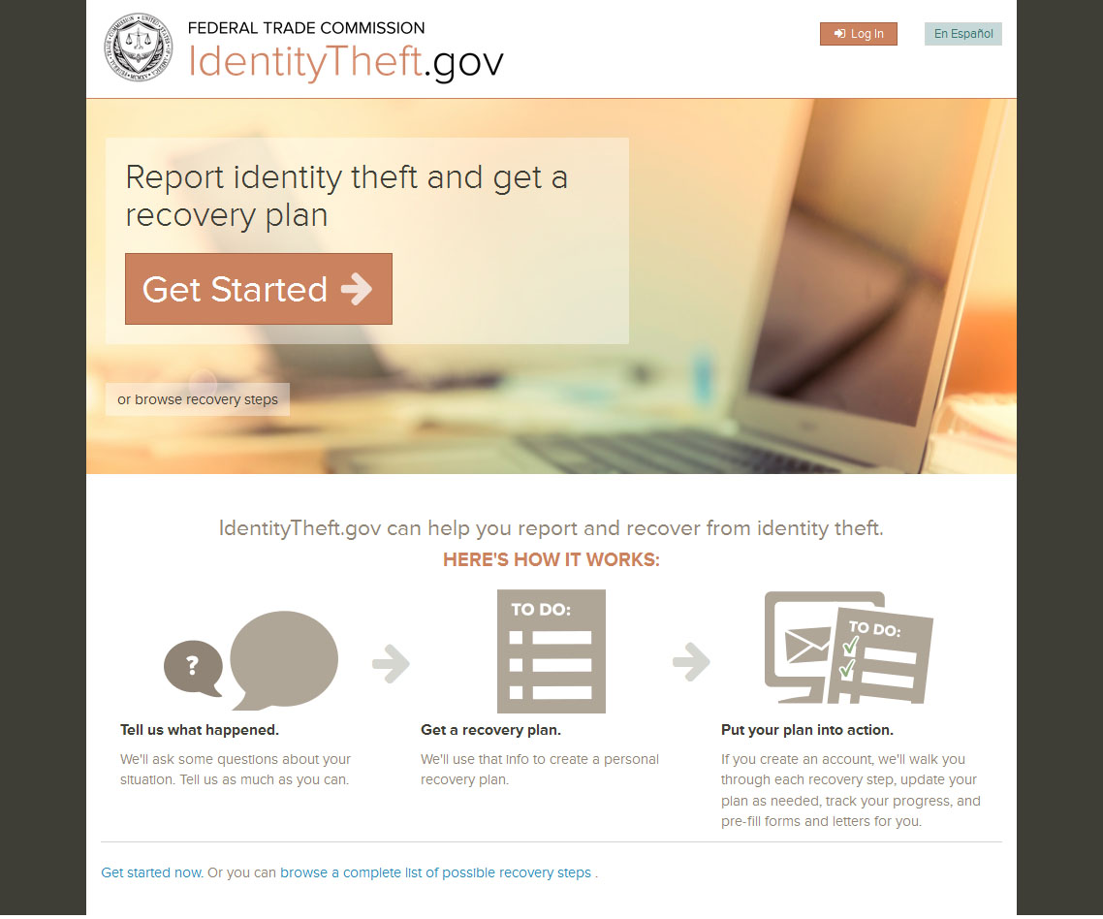

Slide 8
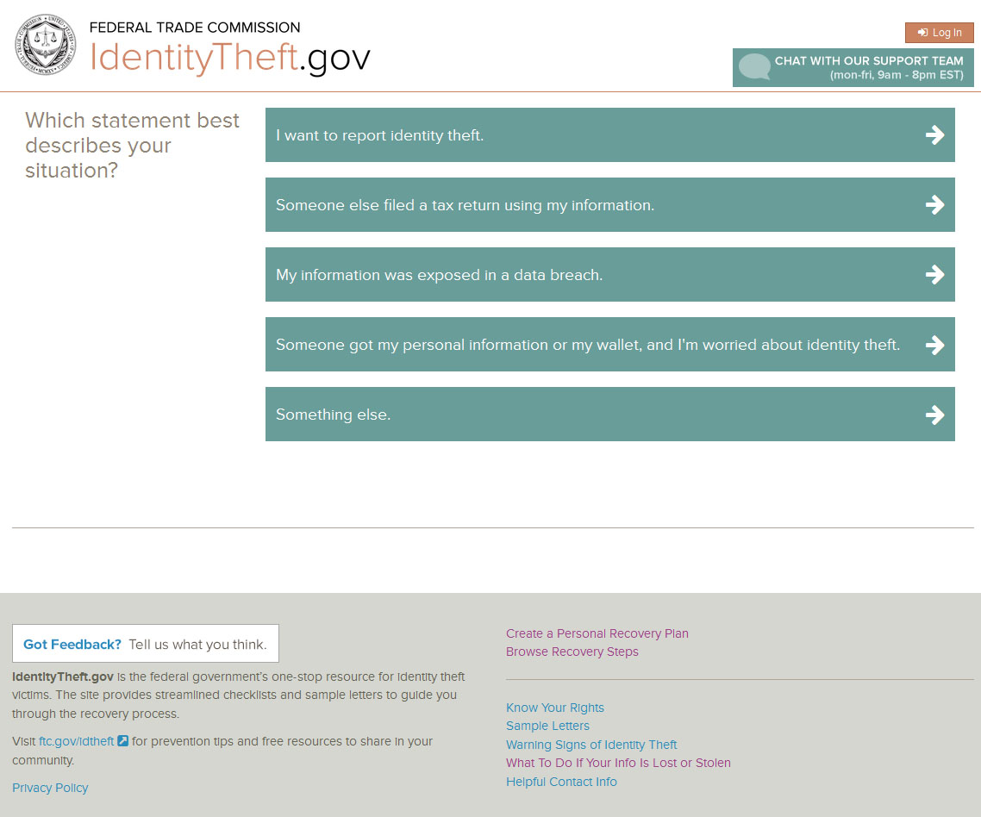
Notes:
When you choose “Get Started” on the homepage, you’ll answer questions about your situation. While the site is designed primarily to report identity theft, you also can get specific advice about related situations, like having information exposed in a data breach, or losing your wallet.

Slide 9
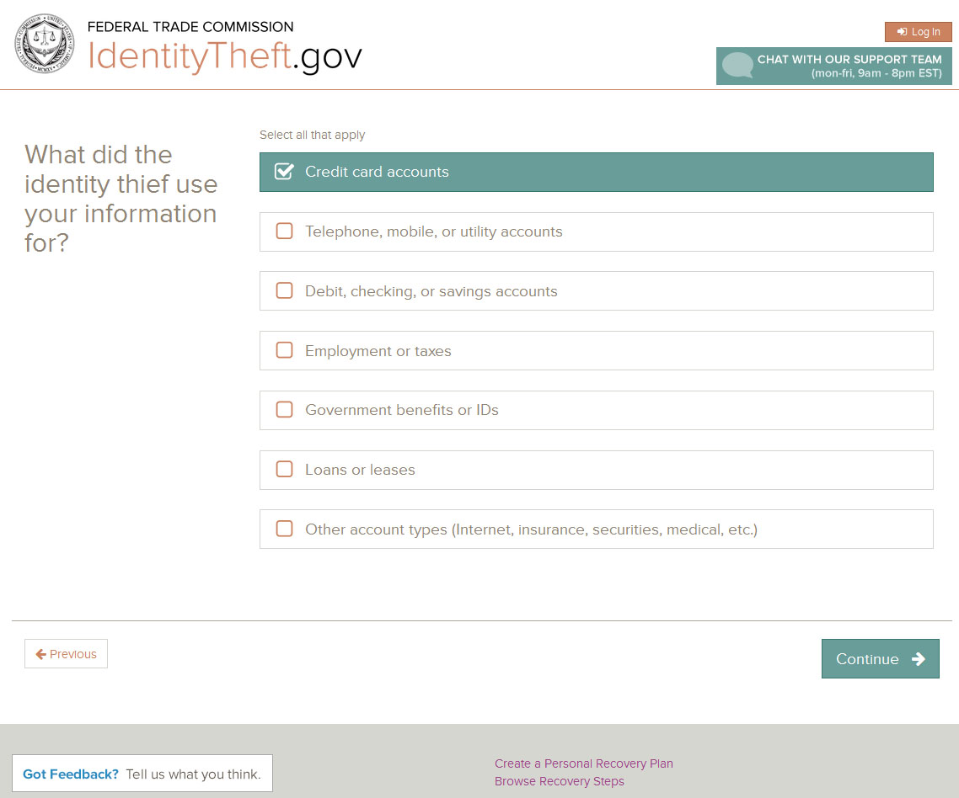
Notes:
Each situation is unique, so we’ve developed a tailored recovery plan for more than 30 different types of identity theft.

Slide 10
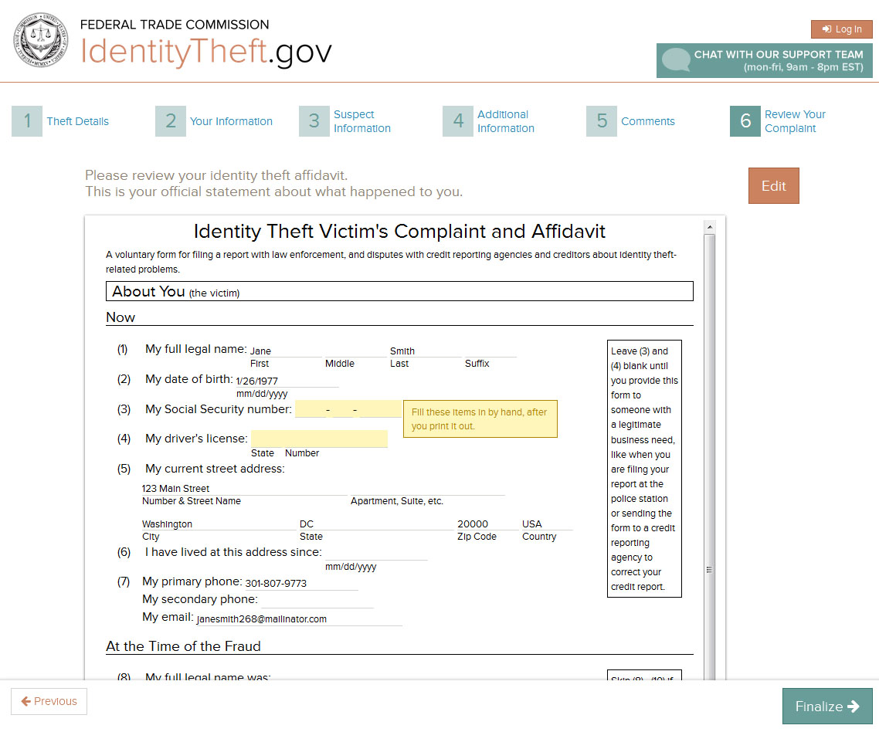
Notes:
After you provide the specific details about your situation, the system will create an Identity Theft Affidavit for you. This is your official statement about what happened to you.
The system was designed with security in mind, so it only collects the information it needs. You’ll enter your Social Security and driver license numbers by hand after you print out your affidavit.

Slide 11
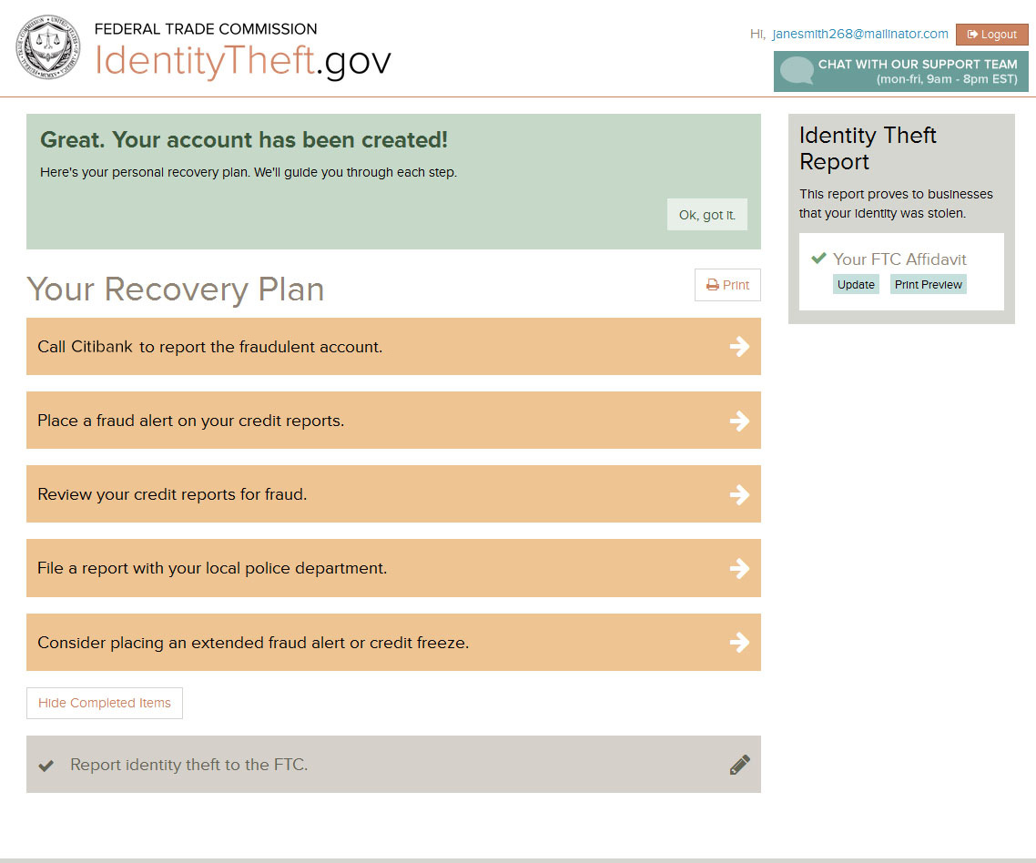
Notes:
Next you’ll get your personal recovery plan, which provides step-by-step checklists to guide you through the process. As your situation changes, your recovery plan will adapt. For example, if calling the business doesn’t solve the problem, the system will suggest the next step -- like sending a follow-up letter. Your recovery plan evolves with you. If you find a new fraudulent account, you can update your information, and your recovery plan will update, too. Never before has an identity theft victim had a dynamic resource like this. And the entire system is available in Spanish too.

Slide 12
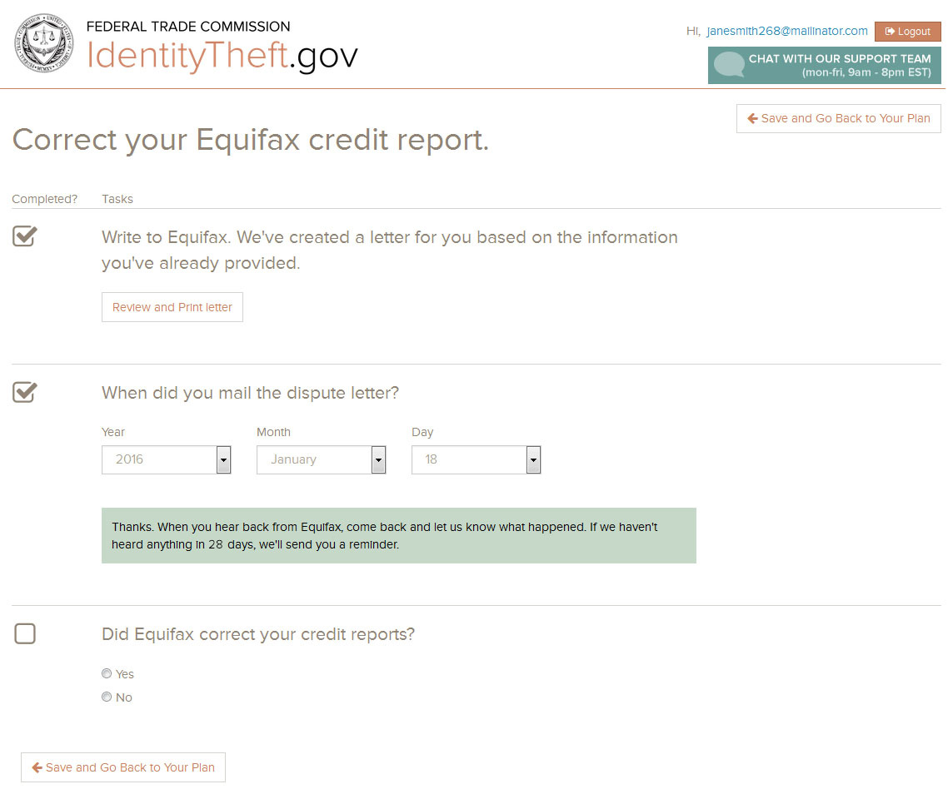
Notes:
Here’s an example of a specific recovery step.

Slide 13
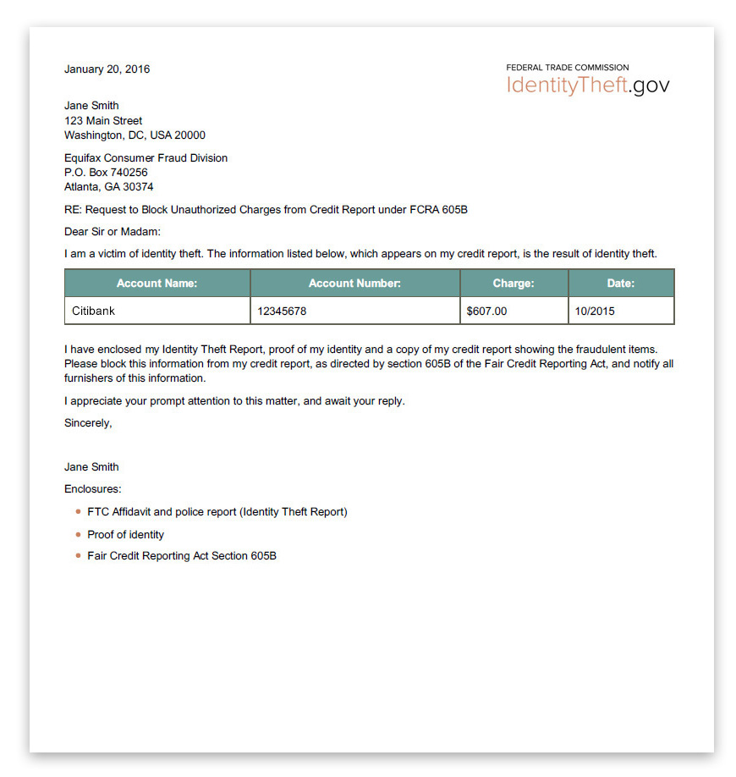
Notes:
The system automatically creates pre-filled letters that you can send to credit bureaus, businesses, and debt collectors. The letters just need to be printed, signed, and mailed.

Slide 14
Recovering from identity theft is easier with a plan.
Notes:
These pre-filled letters are just one example of how IdentityTheft.gov saves people time, and gives them confidence to exercise their rights. Please help us spread the word about the site, so identity theft victims know there’s a place to get help.

